Slide 1
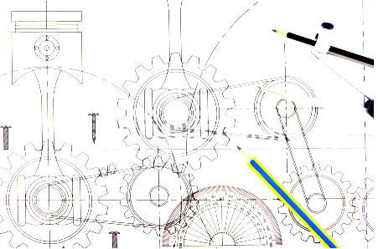

Engineering Drawing
L4_Projection Theory
B. SANTHI
Department of Mechanical Engineering
NIT Goa
santhi@nitgoa.ac.in

Slide 2
••• Recap from the last class
Why Engineering Drawing - INTRODUCTION
DRAWING INSTRUMENTS
DRAWING SHEET
LINES
LETTERING
DIMENSIONING

Slide 3

PROJECTION OF AN OBJECT

Slide 4
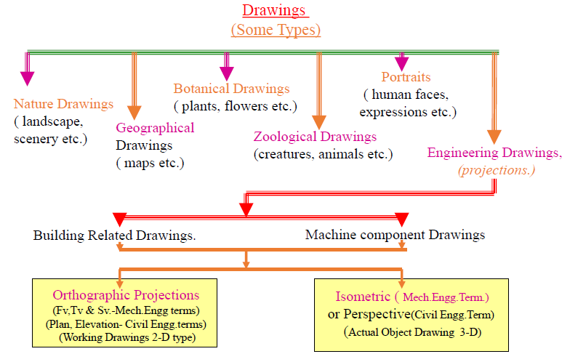

Slide 5
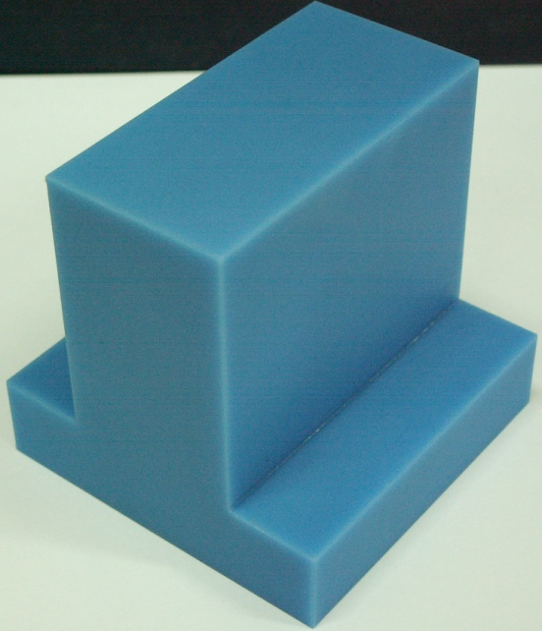
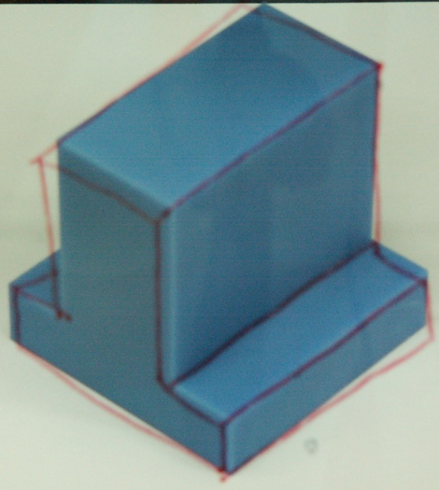
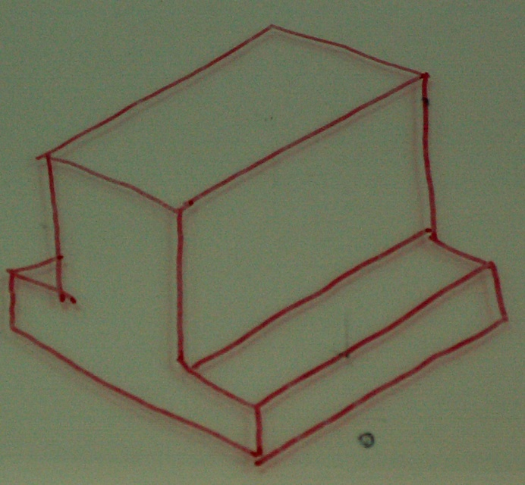
Purpose
To graphically represent a 3-D object on 2-D
Object (3D) placing
on the paper (2D)
Transparent plate is placed
between object and
observer’s eyes.
A view of an object on
2D media
Inconvenient to
communicate
Object’s features are transferred
through projection.
Convenient to
communicate

Slide 6
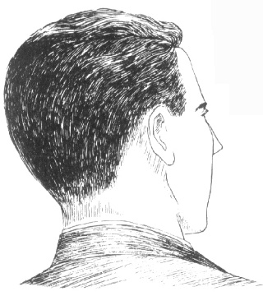
Concept
A projection theory is based on 2 variables:
1) Line of sight
2) Plane of projection (image or picture plane)
1. Line of sight (LOS)
an imaginary ray of light
between an observer’s eye
and an object.
LOS
projection
line
2. Plane of projection
an imaginary flat plane upon
which the image created by the
LOS is projected.
Object and Observer also important

Slide 7
Line of sight
Lines of sight can be parallel or converge.
Parallel projection
Converge projection
Orthographic Projection
Oblique Projection
Axonometric-Isometric, Dimetric, Trimetric Projection
Perspective Projection

Slide 8
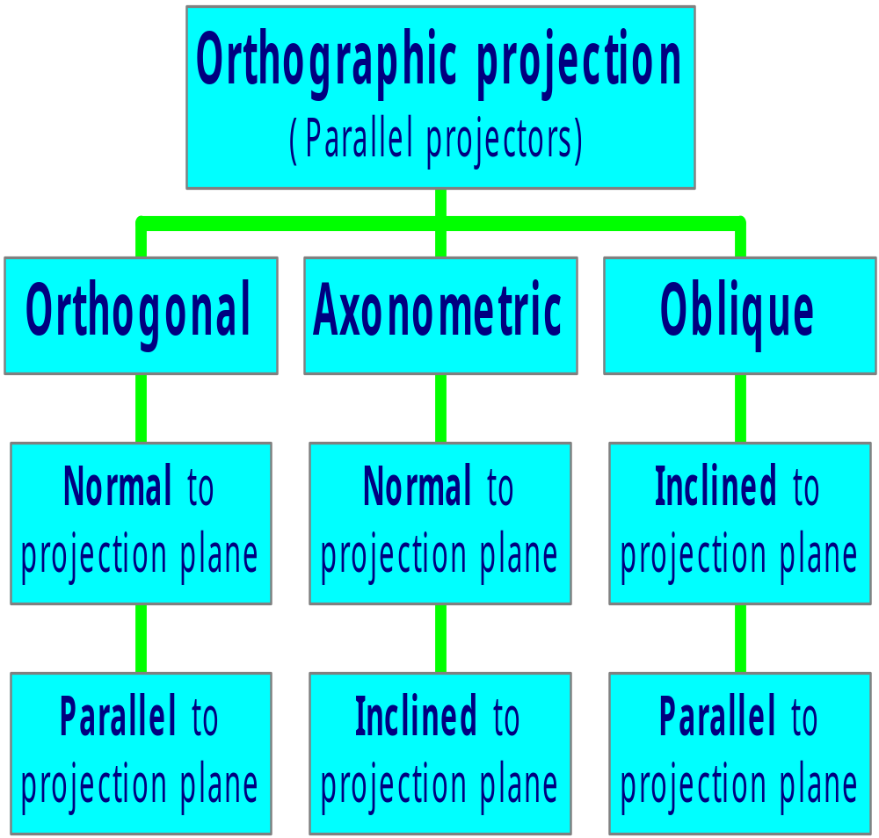
Projectors
Principal
plane of
object

Slide 9
Object features
Edge is a line that represent the boundary between two faces of an object.
Surface limit is a line that represents the last visible part of the curve surface.
Surface is an area that are bounded by edges or surface limit. Surface can be plane or curve.
No edges!
Prism
Cylinder
Sphere
Note
These features will appear as lines in a multiview drawing.

Slide 10
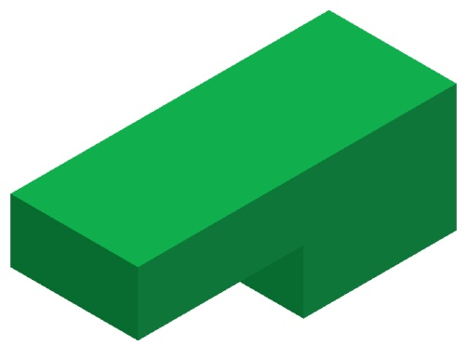
Projection of an object
Glass box concept
Multiview drawing
Hidden line is used
to show existence of
a hidden edge.
Do the same procedures for
all remaining edges (or planes)
Play

Slide 11
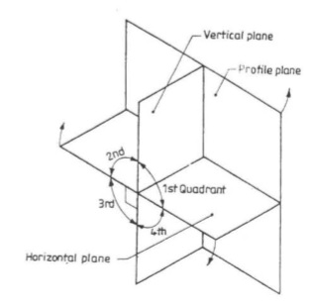
Four quadrants
A plane of projection(POP) is a plane on which a particular view is projected.
In multiview orthographic projections, we need different POPs to draw different views of an object.
Three such planes, perpendicular to each other, are called principal planes or reference planes.
Horizontal plane (HP):a plane parallel to the ground.
Vertical plane(VP) of frontal plane(FP): a plane perpendicular to the ground and intersecting HP.
Profile plane(PP): a plane perpendicular to both HP and VP.

Slide 12
Four quadrants
HP and VP make four quadrants.
HP is rotated clockwise direction
PP is rotated in away from the object.

Slide 13
First angle projection
The object is in the first quadrant.
The projections obtained are "First angle projections“.
The object lies in between the observer and the planes of projection.

Slide 14
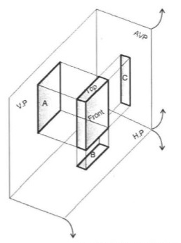
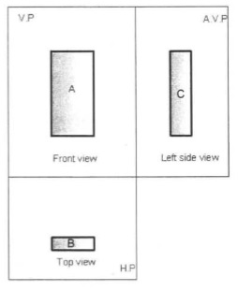
First angle projection

Slide 15
Third angle projection
The object is situated in Third Quadrant.
The Planes of projection lie between the object and the observer.
The front view comes below the xy line and the top view about it.

Slide 16
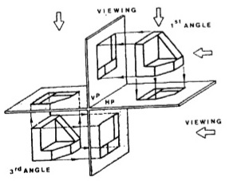


First angle Vs Third angle projections
First angle projection
Third angle projection
The object is in the first quadrant. i.e. object is in front of the V.P. and above H.P.
The object lies in between the observer and the plane of projection.
The plane of projection is assumed to be non- transparent.
The front view or elevation is drawn above the xy line and the top view or plan below xy.
The object is situated in Third Quadrant. i.e. H.P. is assumed to be placed above object and V.P. before the object.
The Planes of projection lie between the object and the observer.
The plane of projection is transparent.
The front view comes below the xy line and the top view about it.

Slide 17
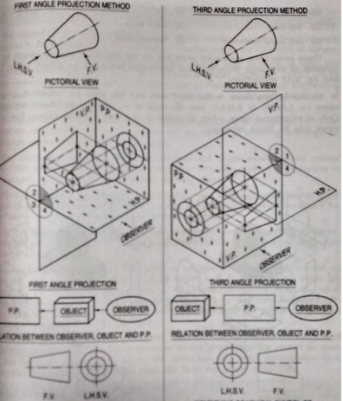
First angle Vs Third angle projections
First angle projection
Third angle projection

Slide 18
Why Second & fourth angle projections not considered?
the second and third quadrants are not used since FV and TV come on same side.

Slide 19
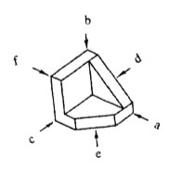
Six different views
An object in space may be imagined as surrounded by six mutually perpendicular planes.
So, it is possible to obtain six different views by viewing the object along the six directions, normal to the six planes.
Six different views:
  1. View in the direction a = Front view
  2. View in the direction b = Top view
  3. View in the direction c = Left side view
  4. View in the direction d = Right side view
  5. View in the direction e = Bottom view
  6. View in the direction f= Rear view

Slide 20
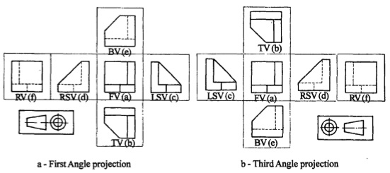
Six different views
In both the methods of projection, the views are identical in shape and size but
their location with respect to the front view only is different.

Slide 21
end

